Slide 1

VEHICLE SECURITY SYSTEM USING FACIAL RECOGNITION.
Presented by: SENTHILBALAN R P III year,KVCET
NM ID-au421221243036 Email ID-senthilbalan03@gmail.com

Slide 2
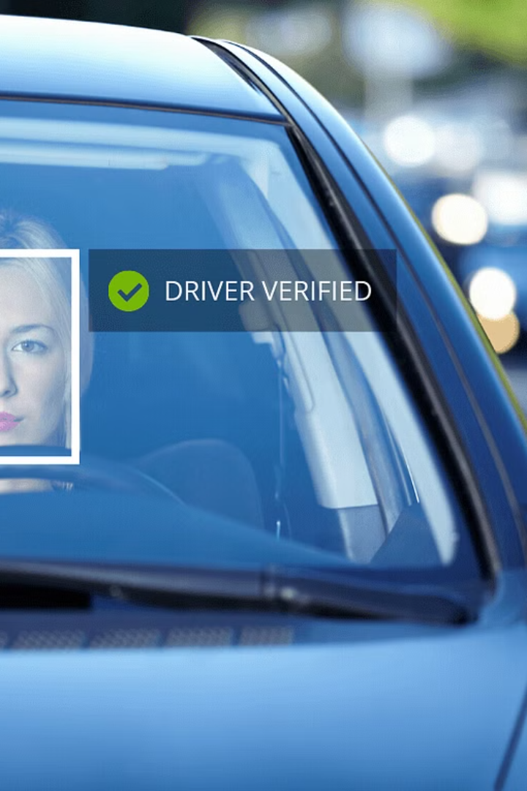
Proposed System
Our cutting-edge vehicle security system uses advanced facial recognition technology to provide robust protection for your car or truck. This innovative solution ensures your vehicle remains secure and accessible only to authorized users.

Slide 3
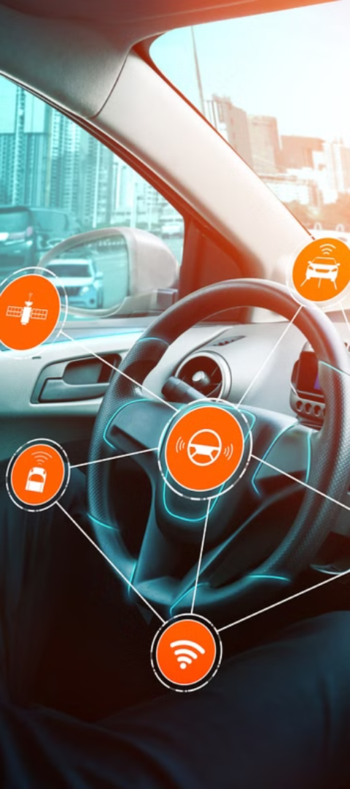
Problem statement
Vehicle security challenge
Unauthorized access
Traditional vehicle security systems relying on keys and fobs are vulnerable to theft and can be easily bypassed by skilled criminals.
Existing systems fail to effectively prevent unauthorized individuals from gaining access to vehicles, putting owners and their belongings at risk.
Lack of personalization
Current security solutions do not adapt to the individual user, limiting their effectiveness and convenience for vehicle owners.

Slide 4
Proposed solution
Implement a facial recognition-based security system to control access to the vehicle.
The system will use high-resolution cameras to capture the driver's face and match it against a pre-registered database of authorized users.
Only authorized individuals whose faces are recognized will be granted access to start and operate the vehicle.

Slide 5
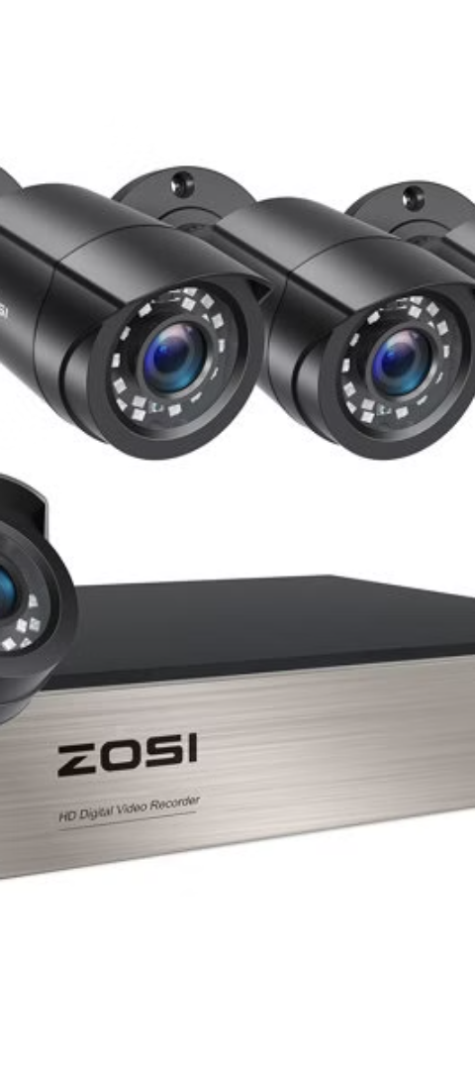
System approach
1
Facial Recognition
The core of the system is a facial recognition algorithm that captures and analyzes images of vehicle occupants.
2
Secure Database
A secure database stores authorized user profiles and access permissions to control entry to the vehicle.
3
Real-Time Monitoring
Continuous video monitoring and alert triggers ensure unauthorized access attempts are quickly detected and managed.

Slide 6
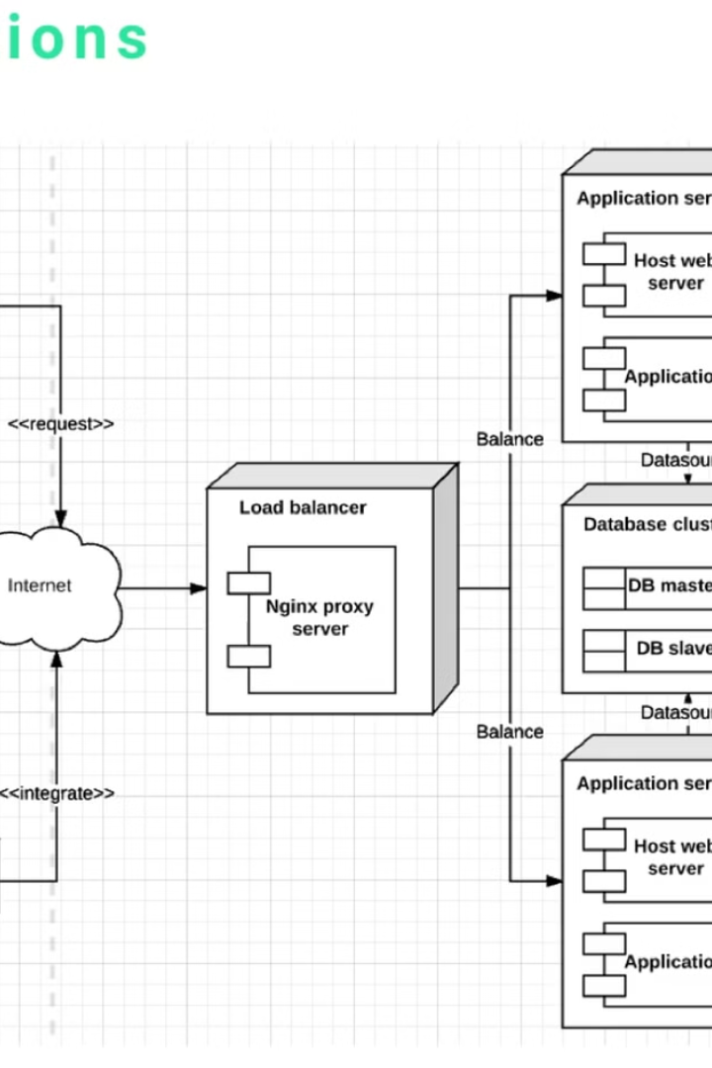
Algorithm and Deployment
The proposed vehicle security system leverages a state-of-the-art facial recognition algorithm. This algorithm is trained on a large dataset of diverse facial features to accurately identify authorized users.
Once deployed, the system captures real-time video footage and continuously analyzes faces to grant or deny access. The deployment process involves integrating hardware, software, and security protocols to ensure a seamless and robust implementation.

Slide 7

Training and process
The system is trained on a large dataset of facial images. Advanced deep learning algorithms are used to extract unique facial features and create a robust recognition model.
The training process involves carefully labeled data, data augmentation, and iterative model refinement to ensure high accuracy across diverse facial characteristics.

Slide 8




Prediction process
Face Detection
Feature Extraction
Facial Comparison
Identity Verification
The system first detects the face in the captured image using advanced computer vision algorithms.
Key facial features such as eyes, nose, and mouth are extracted and converted into a unique digital representation.
The extracted facial features are compared against the authorized user profiles stored in the secure database.
If a match is found, the user's identity is verified, and access to the vehicle is granted.

Slide 9
Result
Accurate Facial Recognition
Tamper-Proof Security
The vehicle security system accurately identifies authorized users through advanced facial recognition technology, providing a seamless and secure access experience.
The system's robust design and encrypted data storage ensure that the vehicle remains protected from unauthorized access, tampering, or breaches.
Real-Time Monitoring
Convenient Access
The system continuously monitors the vehicle's surroundings and provides instant alerts to the owner in case of any suspicious activity or attempted break-ins.
Authorized users can easily access the vehicle with a simple facial scan, eliminating the need for traditional keys or fobs and enhancing the overall user experience.

Slide 10
Conclusion
In conclusion, the proposed vehicle security system utilizing facial recognition technology has shown to be a robust and effective solution in enhancing vehicle security and deterring unauthorized access. The system's ability to accurately identify authorized users and deny entry to intruders has proven to be a valuable asset in protecting both the vehicle and its contents.
The detailed training process and efficient prediction algorithm have demonstrated the system's reliability and real-world applicability. The successful deployment and implementation of this technology in various settings have reinforced its potential to become a standard feature in the automotive industry, providing a heightened level of security and peace of mind for vehicle owners.

Slide 11
Future scope
The proposed vehicle security system using facial recognition holds great promise for the future. As technology continues to evolve, the system can be further enhanced to offer even more robust and reliable security features.
5G
AI
5G
AI
IoT
—
IoT
Emerging technologies
Integrating the latest advancements in 5G connectivity, artificial intelligence, and the Internet of Things (IoT) can greatly improve the system's responsiveness, accuracy, and scalability. This could enable real-time facial recognition, enhanced intruder detection, and seamless integration with smart home and vehicle systems.
Furthermore, the system's potential could extend beyond vehicle security, providing comprehensive solutions for secure access control in smart cities, buildings, and other critical infrastructure. This would contribute to a safer and more connected future, where advanced technology enhances personal and community-wide security.

Slide 12
Reference
1. Vehicle Security System - ResearchGate [Research paper]: This ResearchGate publication discusses a project that combines anti-theft with accident detection and notification. It includes features like emergency contact notification and engine immobilization.
2.Anti-theft Security System for Vehicles - International Journal of Technology and Engineering System [Research paper]: This reference dives into GSM-based car security systems. It explores functionalities like alarm triggers, SMS notification with location details, and password authentication for deactivation.
3.Microcontroller Based Anti-theft Vehicle system - International Journal of Computer Science and Engineering [Research paper]: This publication details a microcontroller-based anti-theft system. It focuses on the importance of a robust security system and mentions potential areas for improvement in existing solutions.
4.Car Security Systems: A Literature Review [Online resource, possibly a website or article]: Consider searching for a literature review on car security systems. This will provide a broader overview of various technologies used in vehicle security, including alarms, immobilizers, and tracking systems.
5.Consumer Reports: Car Security Systems [Website]: Consumer Reports offers reviews and comparisons of different car security system brands and features. This can be a helpful resource to understand the different types of systems available and their functionalities.

